Slide 1
WEEK 4 | AI PROJECT DEPLOYMENT & CAPSTONE
Mall Customer Segmentation
From K-Means model to a deployed Flask application and prediction API

Slide 2
Why segment mall customers?
1
2
3
Problem
Solution
Outcome
Marketing is one-size-fits-all. The mall cannot tell which shoppers deserve loyalty rewards and which need discounts.
Group customers by income and spending score with K-Means, then serve the model through a web app and an API.
Staff enter two numbers and instantly get a segment plus a marketing recommendation.

Slide 3
The dataset: 200 customers, 5 columns
200
customers
Column | Use
CustomerID | Identifier
Gender | Profiling
Age | Profiling
Annual Income (k$) | Clustering feature
Spending Score (1-100) | Clustering feature
0
rows removed in cleaning
2
features used for clustering

Slide 4
End-to-end pipeline
1
2
3
4
5
Clean
Scale
Cluster
Save
Serve
Validate columns, drop duplicates and bad values
StandardScaler keeps features comparable and safe to extend
K-Means with K chosen by silhouette score
Joblib serializes the whole pipeline
Flask page + JSON API, gunicorn ready
train_model.py runs steps 1-4; app.py handles step 5

Slide 5
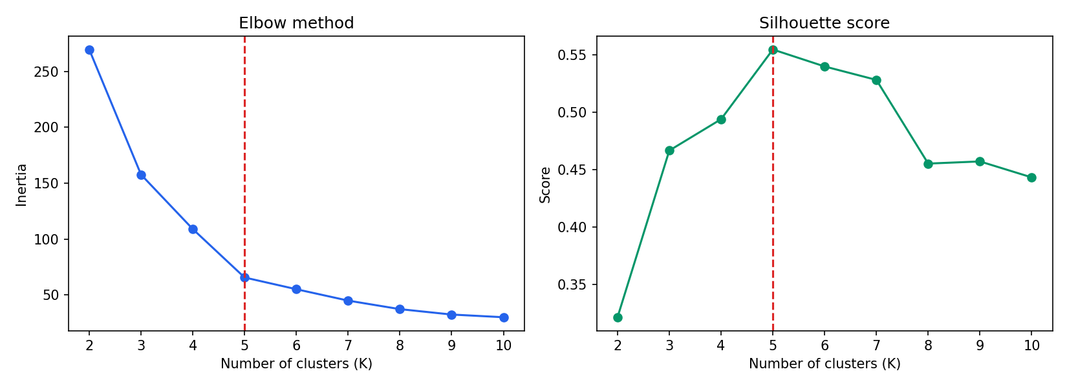
K = 5 is the clear best choice
0.555
highest silhouette score, reached at K = 5
The elbow of the inertia curve also appears at K = 5.
K = 2 to 10 were tested. Silhouette: 0.321 at K=2, 0.494 at K=4, 0.555 at K=5, 0.540 at K=6.

Slide 6
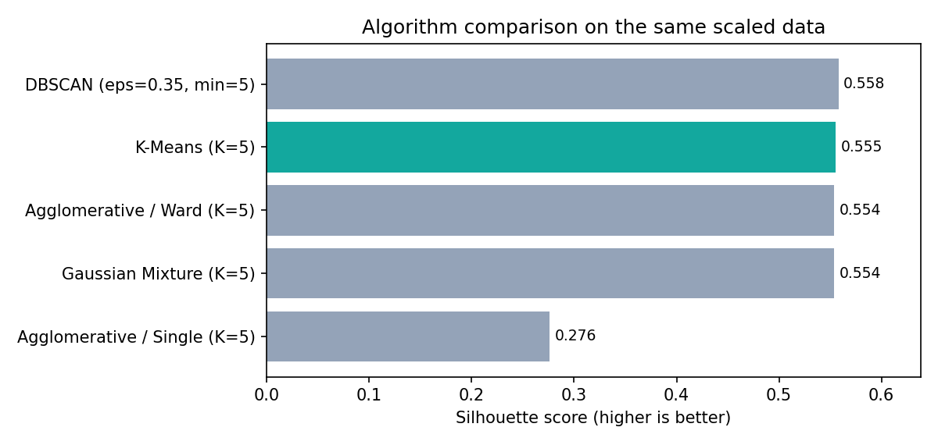
Why K-Means? Five algorithms compared
Top 3 tie
K-Means, Ward and Gaussian Mixture all score 0.554-0.555: the groups are compact and round, so the choice barely matters.
DBSCAN
0.558 only after setting aside 23 customers as noise, and it cannot predict new ones.
Feature test (K-Means, K=5): Income + Spending 0.555, adding Age 0.417, adding Gender too 0.304
Why K-Means
Every customer gets a segment, predict() works for the API, and centroids are easy to explain.

Slide 7
Five segments, clearly separated
0.555
Silhouette
0.572
Davies-Bouldin (lower is better)

Slide 8
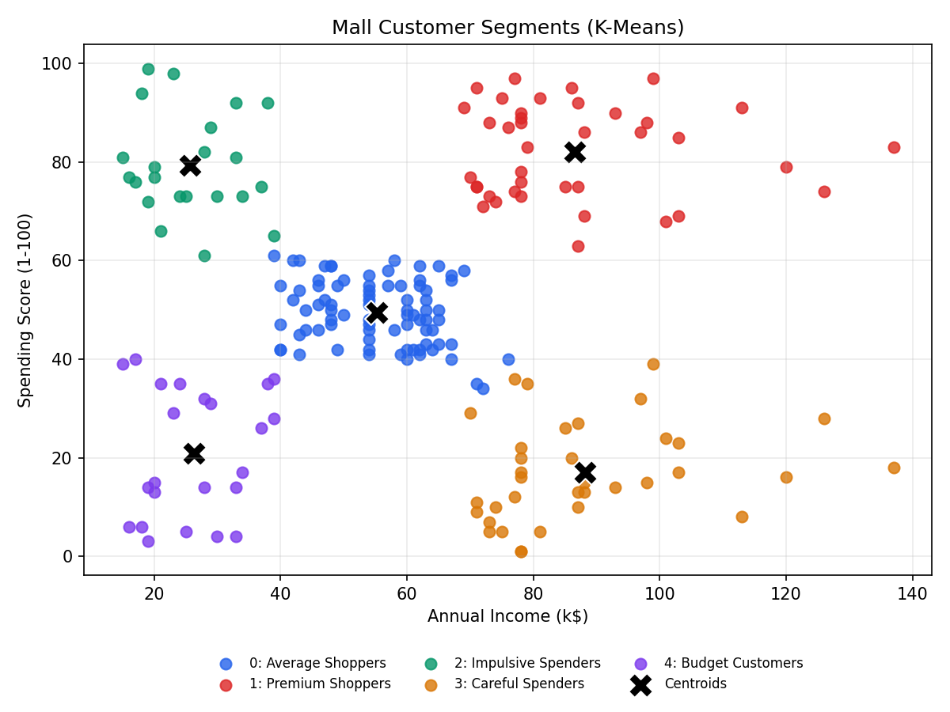
What each segment means
Premium Shoppers
High income, high spend: VIP rewards
Careful Spenders
High income, low spend: personalised offers
Impulsive Spenders
Low income, high spend: flash sales
Budget Customers
Low income, low spend: coupons, bundles
Average Shoppers
Mid income, mid spend: seasonal promos

Slide 9
Bias and ethics: what was checked
Gender
Age as a proxy
Excluded from the model. Chi-square test: p = 0.693, no sign segments depend on gender.
Not a feature, yet Impulsive Spenders are all 18-35. Never use segments for pricing, credit or service.
Unknown score
Privacy
The Spending Score formula and the 200-customer sample are undocumented, so do not generalise.
The API stores nothing. Profiling needs consent and a lawful purpose (GDPR, India DPDP Act 2023).

Slide 10
Serialize once, serve through an API
GET /
Web interface
# train_model.py
joblib.dump(pipeline,
"models/customer_segmentation.joblib")
# app.py
model = joblib.load(MODEL_PATH)
cluster = model.predict(X)[0]
POST /predict
{"annual_income": 90,
"spending_score": 85}
GET /health
Health check
GET /api/info
Model and segment details
POST /predict
Predict one customer's segment
Bad input returns HTTP 400 with a clear error message.

Slide 11
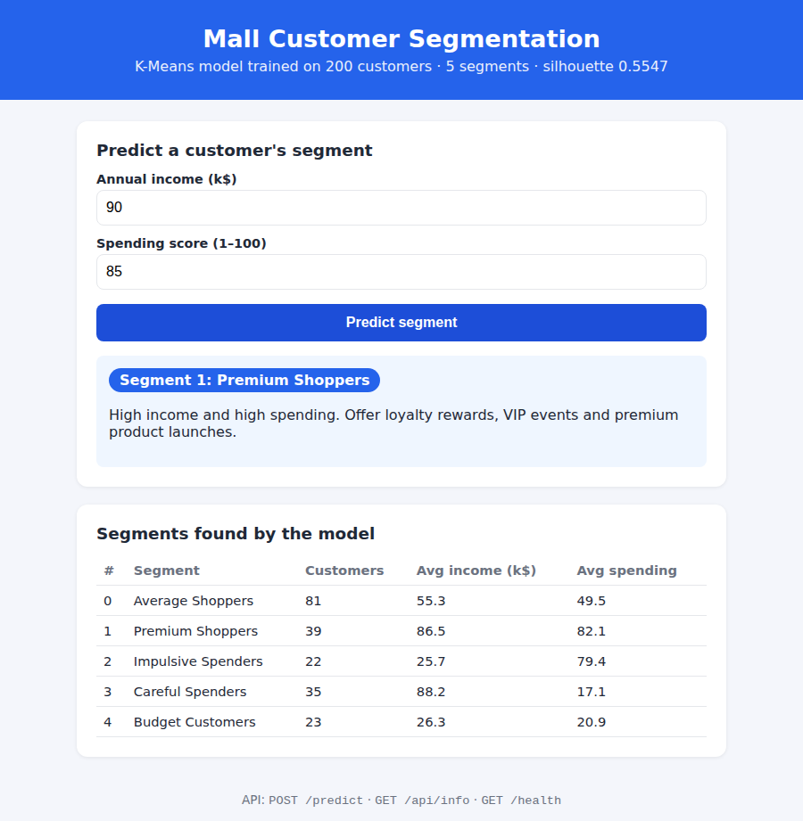
The running web application
1
Enter
annual income and spending score
2
Predict
browser calls POST /predict
3
Result
segment name and marketing advice

Slide 12
17 automated tests, all passing
Pages and endpoints
home, /health, /api/info
17/17
All 5 segments
one example customer per segment
pytest tests passed
Bad input rejected
missing, text, negative, out of range
plus live checks with curl and a browser
Wrong requests
non-JSON body, wrong method, unknown route

Slide 13
Deploy to the cloud in four steps
1
2
3
4
Push
Connect
Build
Live
Upload the folder to GitHub
New Web Service on Render, pick the repo
render.yaml installs packages and trains the model
gunicorn serves the app; /health is monitored
Also supported through the Procfile: Railway, Heroku, PythonAnywhere

Slide 14
Conclusion
Validated data and a scaled K-Means pipeline, silhouette 0.555
Model serialized with Joblib and served by Flask
Web page and JSON API with input validation
17 passing tests; cloud-ready with gunicorn and render.yaml
Next steps
Add Age and Gender to the model | CSV batch prediction | Docker image | Scheduled retraining

